Slide 1
Task 4: Product Matching
Prepared by: Wajahat Ali Mughal
Student ID: 001191074
Supervisor: Prof. Hai Huang

Slide 2
Scope
To create a system which could be able to differentiate between the products categorically and specifically.
To provide a generic strategy for determining which conventional machine learning approach is suitable for the task.
To Classify the Matched and Not Matched products from the Product offers.
To find Similarity vectors using the Blocking Strategy by using the record pairs.

Slide 3
methodology
The proposed system is composed of a multitude of subsystems, including data preparation, text comparison, categorization, and performance analysis. A feature selection and cleaning strategy will be implemented as part of the data pre-processing. The suggested model makes advantage of Levenshtein for Text Similarity so that it may more effectively extract characteristics from the input data, and as a result, increase the accuracy of the model. After the features have been retrieved, they are entered into a classification model, where they are utilised to decide whether or not the marketed product is a suitable match for the features that were originally gathered.
In order to accomplish this, we make use of a Random Forest Classifier. I have also tested other classifiers such as Decision Tree and Support Vector Machine(SVM) The evaluation of a model is completed with the final steps of computing the model's precision and f1score.

Slide 4
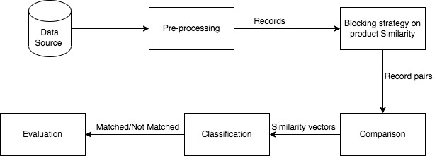
Proposed Flow of the Model

Slide 5
Problem Area That the Project Addresses
As part of the regular expression challenge, the model must look for titles and description of the same product that include different terms, but are otherwise comparable. Strategies for dealing with this issue have been identified in the research effort.
In small datasets, SVM classification performs admirably, but when faced with a large dataset, its performance suffers since it relies on determining the margin between classes.
There are several kinds of data in the dataset that complicate the data transformation process and force it to process each column separately, which reduces model performance.

Slide 6

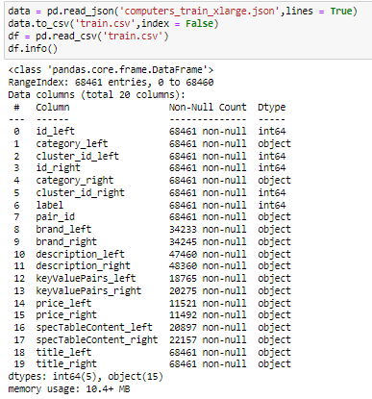
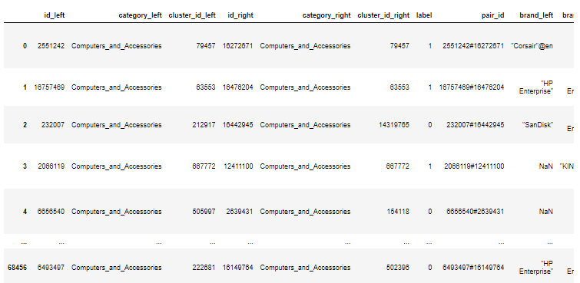
Train-Dataset
As we can see our dataset has 20 columns most of them are not relevant to us in the process of training the dataset so on next step we excluded those columns for better focus on the features we needed for training the dataset.

Slide 7
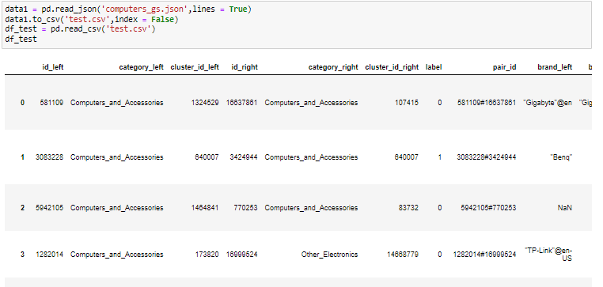
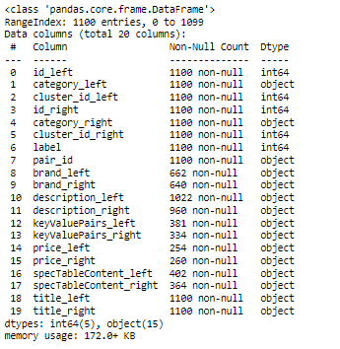
Test-Dataset
We have give Label as a target for testing the data as it is match or not.

Slide 8
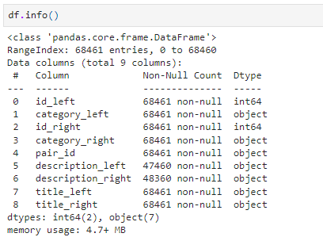
Description of the Proposed flow
Data Pre-processing and Analysis
System Proposal As part of the process of cleaning and analysing raw data, the Json file must first be converted to a tabular format. The read Json function from panda's library is used for this purpose.

Slide 9
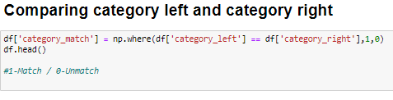


Data Cleaning and preprocessing
By Comparing the category we add a new column which determines that if the category matched by 1 and not matched by 0 and then we exclude the non matched categories.

Slide 10
Text Similarity
Levenshtein Distance
The significance of Levenshtein distance lies in the fact that it is be used to compare strings of different lengths.
Typically, the Levenshtein distance is computed by first constructing a (M+1) x (N+1) matrix, where M and N are the respective lengths of the two words, and then iteratively calculating some value between two for loops.
Accordingly, if the Levenshtein distance between two strings is big, it indicates that the documents are dissimilar, whereas a small number indicates that the documents are comparable.

Slide 11
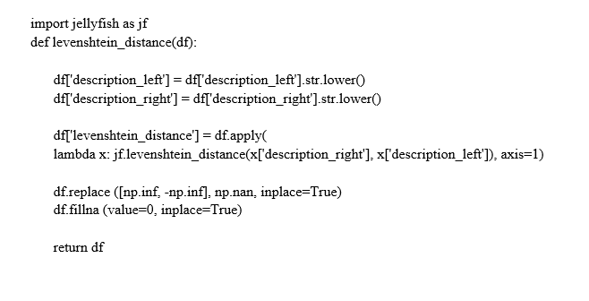
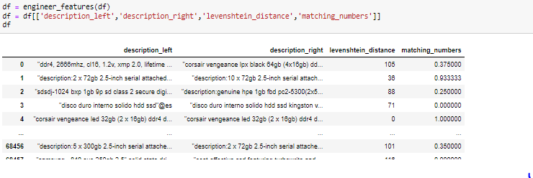
Text similarity
Syntax

Slide 12
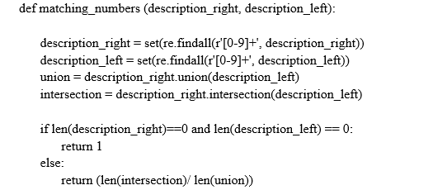
Matching numbers
The regular expression module applies patterns with various metacharacters, and the matching number’s function is used to compare the product description.
Syntax:

Slide 13
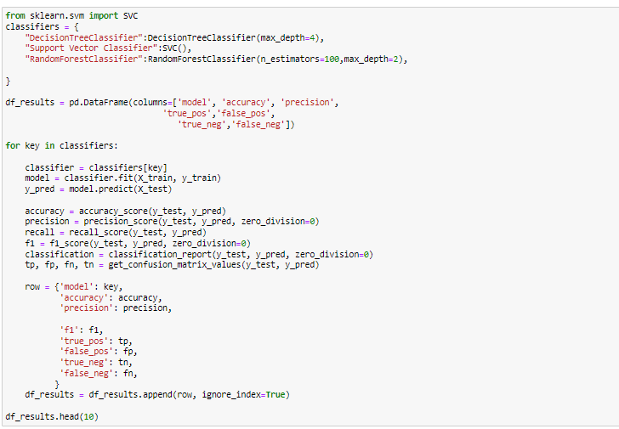

Model building
The Training set and the validation set must be created before a model can be constructed and their results compared.

Slide 14
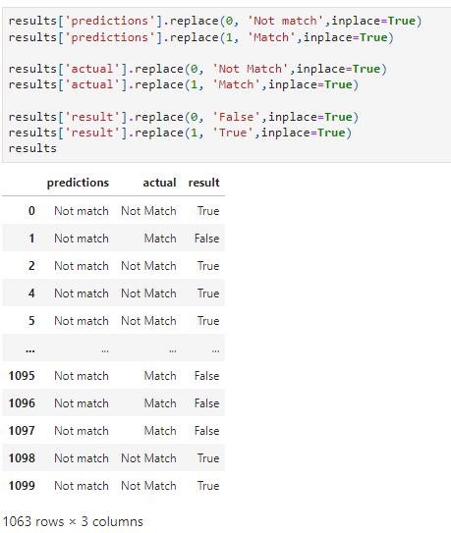
Evaluation and Testing
When the Model is applied, a comparison is made between the predicted and observed values, and a column containing Boolean results is produced.

Slide 15
Precision
Precision:
Precisely how many anticipated Positives turn out to be correct is called "precision." When you want to be absolutely certain about your prediction, precision is an excellent option of evaluation metric.
Precision = (TP)/(TP+FP)

Slide 16
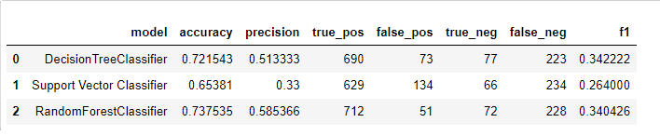
Comparison of Algorithms
As can be seen above, in the suggested algorithm, the Random Forest classifier was chosen rather than the Decision Tree classifier and the Support Vector Machine classifier for the many reasons that were discussed above.

Slide 17
Comparison of Algorithms
The insight behind Decision Trees is that it use the dataset features to create yes/no questions and continually split the dataset until it isolate all data points belonging to each class. With this process the data is organise in a tree structure.
Training data algorithms are vulnerable to overfitting when resources are limited. When a dataset doesn't meet the validation criteria, it has a negative effect on the new data model. Overfitting is a more likely outcome in these cases, making decision trees less reliable. The random forest technique, alternatively, uses many trees to both lessen its vulnerability and ensure that its performance is unaffected by the addition of these trees. Scaling and normalisation are performed automatically during training.
In contrast SVC ensemble algorithms that divide the input space into hyper-rectangles based on the target, that best separates the tags. This line is the decision boundary. SVC (Support Vector Classifier) uses the kernel method to transform a linearly nonseparable problem into a linearly separable one.

Slide 18
Conclusion
We used this because Tree-based algorithms are great at handling different kind of data. the dataset can have a mix of numerical and categorical data, and we won’t need to encode any of the categorial features.
Utilizing several data science libraries, a method was developed for the purpose of carrying out feature selection and cleaning as part of the pre-processing phase of the data. The proposed model makes use of Levenshtein's technique for determining textual similarities. The retrieved features are then placed via a classification algorithm to assess whether or not they are a suitable fit for the advertised goods.
The data was tough to clean and pre-process in the appropriate manner because it was based on objects in the column.
Given that multiple algorithms have the potential to complete the text similarity task, selecting the right similarity distance technique presented a considerable difficulty.

